Slide 1

Application of GenAI LLMs for Threat Scenario Generation for TARA Assessments
Saket Mohan
Founder/CEO
An Automotive Cybersecurity Software Company
1

Slide 2

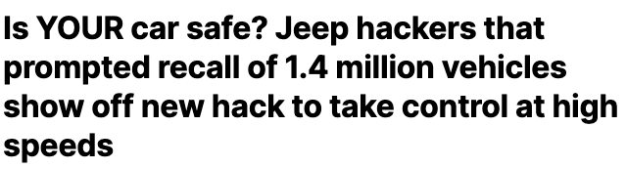















Cybersecurity Attacks on Rise
Mobility companies have seen an exponential rise in automotive cybersecurity attacks
Aug 2023-
Dec 2022-
Apr 2022-
Feb 2021-
Aug 2020- 2019-
2019-
2017-
6

Slide 3
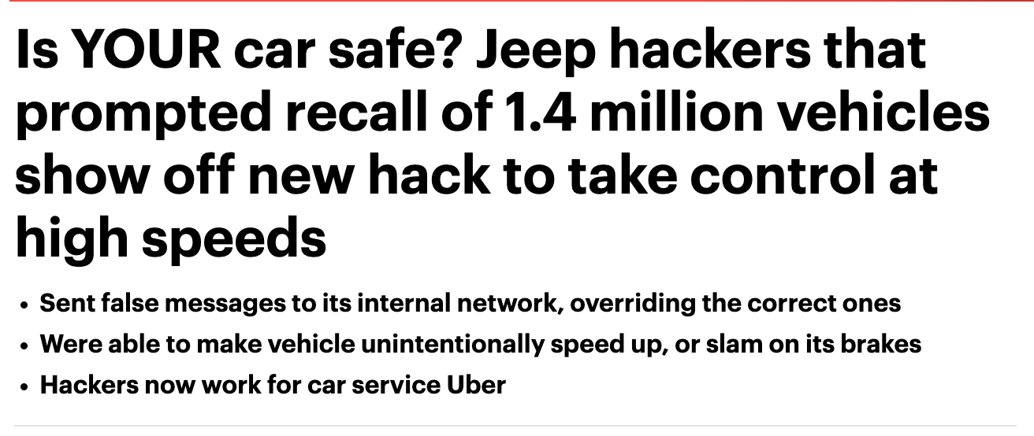
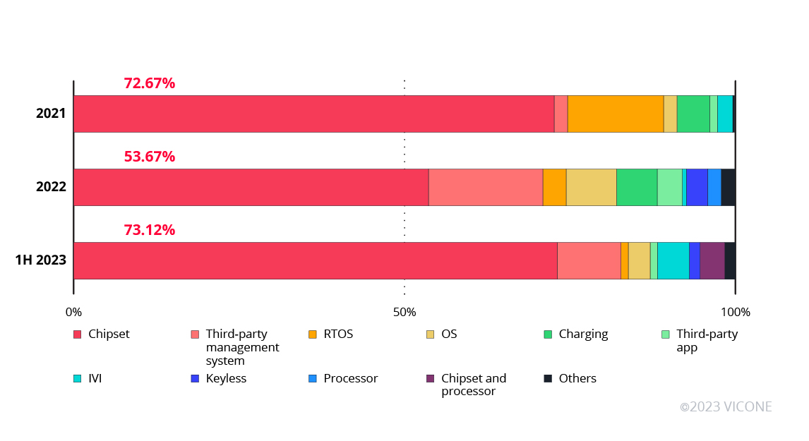
Cybersecurity Vulnerabilities on Rise
Mobility companies have seen an exponential rise in automotive cybersecurity attacks and Vulnerabilities
Aug 2023-
Dec 2022-
Apr 2022-
Feb 2021-
Aug 2020- 2019-
2019-
2017-
Attacks on telematic servers account for 43% of all attacks (up from 35% in 2022) and
Attacks on infotainment systems account for 15% of all attacks (up from 8% in 2022).
Credits – Upstream and Vicone
5

Slide 4
Overview of TARA (Threat Assessment and Risk Analysis)
Introduction to TARA
Overview of TARA (Threat Assessment and Risk Analysis)
Purpose of TARA- systematic approach used to identify, assess, and prioritize potential security threats and risks in software-defined vehicles
Key Components of TARA
Threat Identification: Identifying potential threats that could exploit vulnerabilities within the vehicle's electronic systems.
Risk Analysis: Evaluating the likelihood and impact of identified threats, typically through qualitative or quantitative methods.
Mitigation Strategies: Developing and implementing security measures to reduce the risk associated with each identified threat
TARA as defined in ISO/SAE 21434- ISO/SAE 21434 provides a framework for ensuring cybersecurity throughout the vehicle's lifecycle, from design to decommissioning
Importance in evaluating risks for software-defined vehicles
Complexity of Modern Vehicles
Implications for Safety and Compliance

Slide 5
Overview of TARA (Threat Assessment and Risk Analysis)
Significance of Threat Modeling in Cybersecurity
Role of Threat Modeling:
Threat modeling is a proactive approach that allows organizations to anticipate potential cyber threats and design systems that are resilient to those threats.
In the context of automotive cybersecurity, threat modeling helps in identifying specific attack vectors that could target a vehicle's software and hardware components
Common Threat Modeling Techniques:
STRIDE Model: A common threat modeling framework used to identify threats related to Spoofing, Tampering, Repudiation, Information Disclosure, Denial of Service (DoS), and Elevation of Privilege.
Attack Trees: A diagrammatic approach that helps in understanding how different threats can lead to a specific security breach, allowing for targeted mitigation.

Slide 6
Overview of TARA (Threat Assessment and Risk Analysis)
Current Challenges in TARA
Evolving Threat Landscape
The rise of autonomous driving and advanced driver-assistance systems (ADAS) introduces new vulnerabilities that need to be addressed through updated TARA methodologies
Reliance on Static Documentation
Difficulty in keeping up with evolving threats
Challenges with sophisticated attackers and dynamic threat vectors
Need for Dynamic and Updated Approaches
TARA need to update dynamically

Slide 7
Overview of TARA (Threat Assessment and Risk Analysis)
UNECE Annex 5
Primary reference for TARA in the domain
UNECE Annex 5 is a critical document that serves as a cornerstone for Threat Assessment and Risk Analysis (TARA) in the automotive sector.
It provides a structured approach for identifying and evaluating cybersecurity threats specific to software-defined vehicles, making it a primary reference for professionals in this field.
Collection of threat scenarios and mitigation techniques
The annex includes a comprehensive collection of potential threat scenarios that could impact vehicle safety and security.
It also outlines various mitigation techniques that can be employed to counteract these threats, offering a standardized methodology for securing vehicle system
Limitations of Current Annex 5 Documentation
Static Nature of Documentation
Limited Contextualization
Rigidity in Mitigation Strategies

Slide 8
Overview of TARA (Threat Assessment and Risk Analysis)
Introduction to GenAI LLMs
What are GenAI LLMs?
Large Language Models (LLMs) are advanced AI systems designed to understand and generate human-like text based on vast amounts of data. These models are trained on extensive datasets, enabling them to process and produce text in a wide range of contexts
Capabilities: LLMs, such as GPT-4, are capable of understanding complex language patterns, generating coherent narratives, answering questions, summarizing large bodies of text, and even creating new content
Application in Threat Scenario Generation
LLMs can be leveraged to generate dynamic and context-specific threat scenarios by analyzing and interpreting large datasets related to cybersecurity threats.
Contextualization: These models can produce threat scenarios that are tailored to the specific environment or system being analyzed, taking into account unique variables that might influence potential vulnerabilities
Example Applications
In cybersecurity, LLMs can simulate how new threats might exploit vulnerabilities in software-defined vehicles, helping companies to preemptively strengthen their defenses.

Slide 9
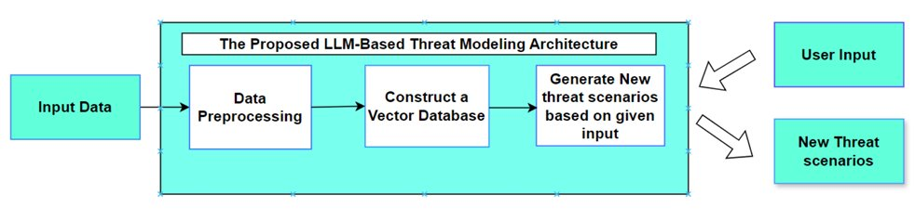
Overview of TARA (Threat Assessment and Risk Analysis)
Methodology
Sample Threat Description
UNECE R155 data
Open source Threat data
N number of New Threat Scenarios

Slide 10
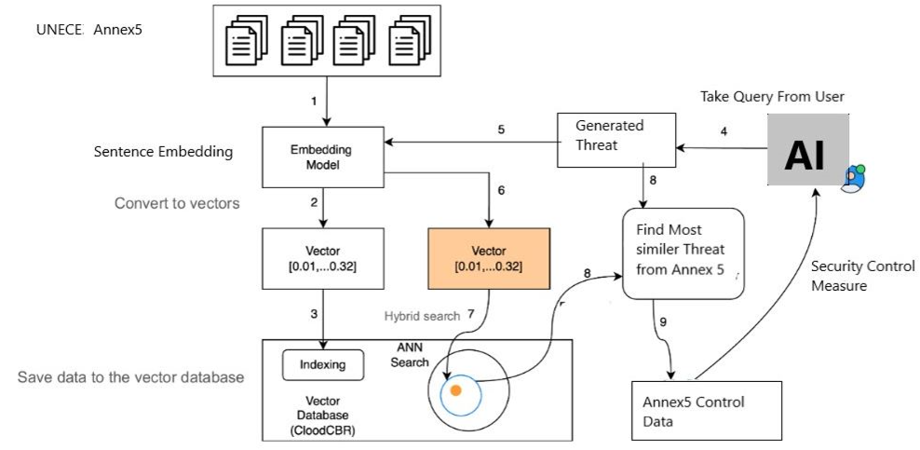
Overview of TARA (Threat Assessment and Risk Analysis)
Mitigation Techniques

Slide 11
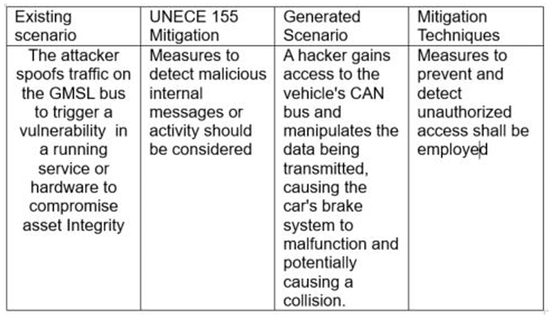
Overview of TARA (Threat Assessment and Risk Analysis)
Validation and Assessment
Map the UNECE 155 mitigation techniques to those generated by LLMs to validate both the threat scenarios and corresponding mitigation strategies

Slide 12
Overview of TARA (Threat Assessment and Risk Analysis)
Key Findings
How the methodology enhances the comprehensiveness of TARA
The application of LLMs in Threat Assessment and Risk Analysis (TARA) significantly enhances the comprehensiveness of threat identification. By leveraging AI, the methodology can dynamically generate and analyze a broader spectrum of potential threats, including those that may not have been previously considered.
This approach allows for a more thorough exploration of vulnerabilities and potential attack vectors, leading to a more robust risk management strategy.
Benefits of incorporating dynamic threat scenarios
Incorporating dynamic and contextual threat scenarios generated by LLMs offers a more adaptable and responsive approach to cybersecurity. These AI-driven scenarios can be continuously updated to reflect the latest trends in cyber threats, ensuring that the TARA process remains relevant and effective.
This adaptability helps organizations stay ahead of emerging threats, improving the overall security posture of software-defined vehicles.
Impact on Cybersecurity for Software-Defined Vehicles
Improved Resilience and Security

Slide 13
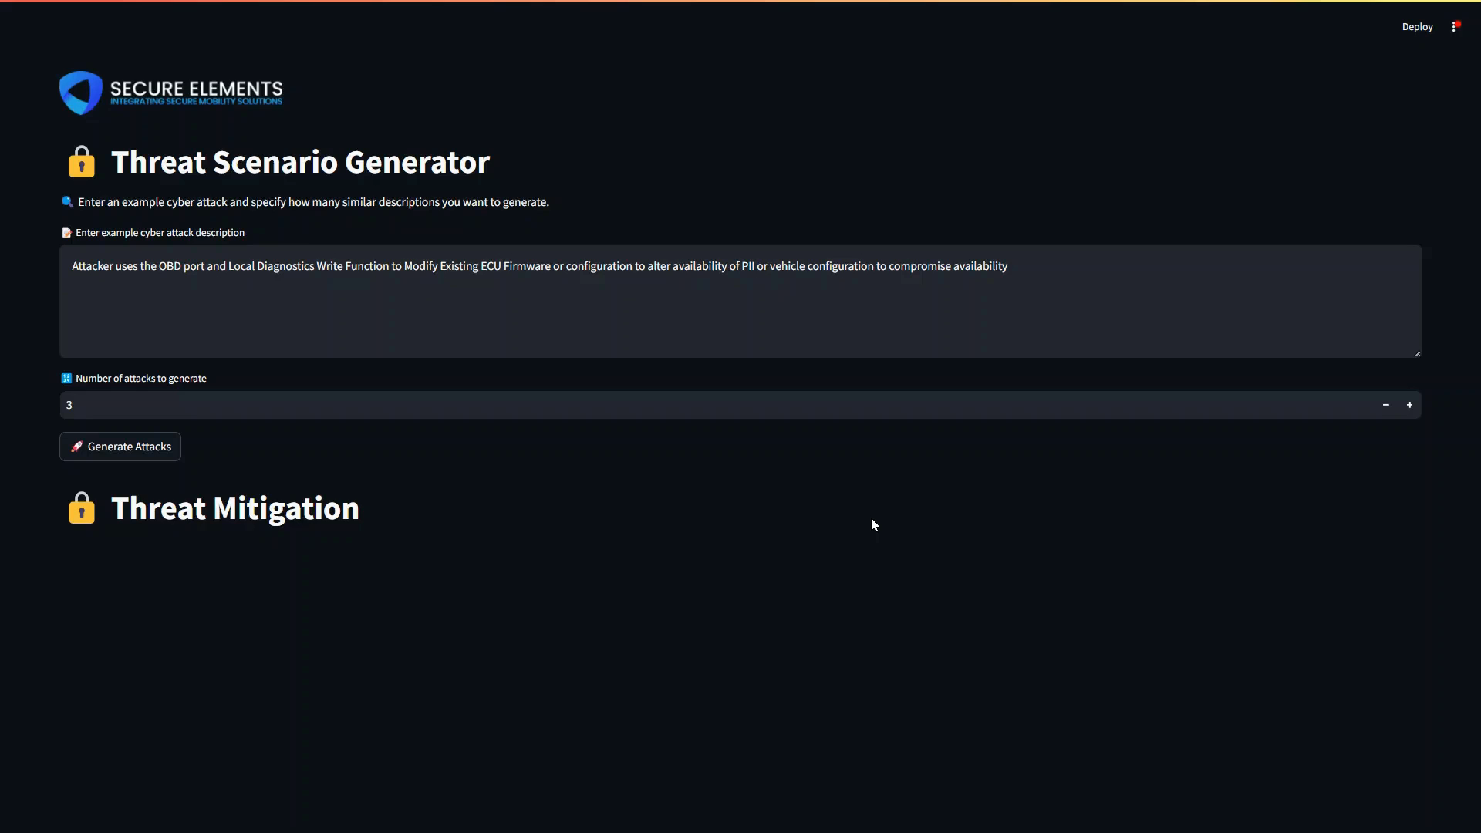
Overview of TARA (Threat Assessment and Risk Analysis)
Case Study

Slide 14
Overview of TARA (Threat Assessment and Risk Analysis)
Challenges and Considerations
Challenges in the Implementation of GenAI LLMs for TARA:
Complexity of integrating AI-driven models into existing cybersecurity frameworks.
Need for substantial computational resources.
Ensuring accuracy and relevance of generated threat scenarios.
Data privacy and security concerns related to large datasets used for training.
Considerations for Organizations Looking to Adopt This Approach:
Evaluating the cost-benefit ratio to justify the investment.
Need for skilled personnel to manage and interpret AI-driven outputs.
Ensuring long-term sustainability of AI models amidst evolving cyber threats.
Developing strategies to integrate these tools into existing cybersecurity practices effectively.

Slide 15
Overview of TARA (Threat Assessment and Risk Analysis)
Future Directions
Possible enhancements to the LLM-driven approach
Future iterations of the LLM (Large Language Model)-driven approach could incorporate real-time data integration, allowing the model to continuously adapt to new and emerging threats. This dynamic capability would ensure that the TARA (Threat Assessment and Risk Analysis) process remains effective and relevant as the cybersecurity landscape evolves.
Enhancements could also focus on improving the model's ability to analyze more complex, multi-layered threats, thereby providing more granular and actionable insights for security teams.
Implications for future TARA assessments and cybersecurity practices
Integrating real-time data into the model will have significant implications for future TARA assessments, enabling organizations to stay ahead of cyber threats by responding to them as they arise. This proactive approach could set a new standard in cybersecurity practices, making systems more resilient and less vulnerable to attacks.
Over the long term, the continuous improvement of this AI-driven methodology could lead to more comprehensive and effective cybersecurity frameworks, not only for software-defined vehicles but also for other technology-driven sectors.

Slide 16
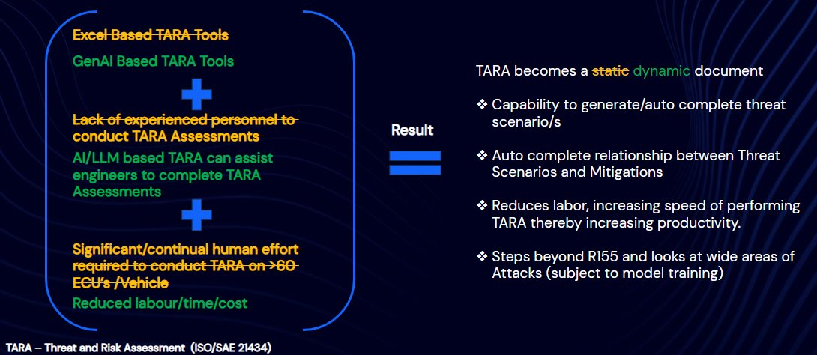
Overview of TARA (Threat Assessment and Risk Analysis)
Conclusion

Slide 17
Overview of TARA (Threat Assessment and Risk Analysis)
Q&A
Thank you!!!
https://secureelements.co.uk
info@secureelements.co.uk
info@secureelements.co.uk

